Slide 1
New Advances in Joint Replacement Surgery and Rapid Rehab
Robin Fuchs, MD
ProOrtho Orthopedics
425 823-4000
FuchsMD.com

Slide 2
Total Hip Replacement

Slide 3
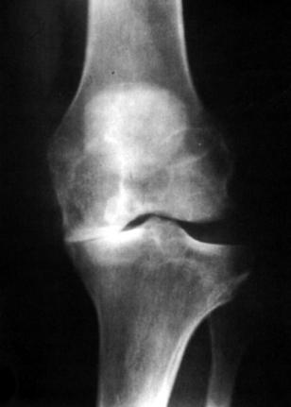
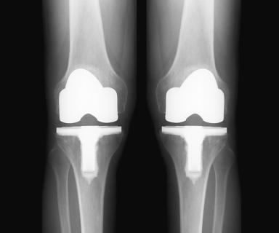

Slide 4
Partial Knee Replacement

Slide 5
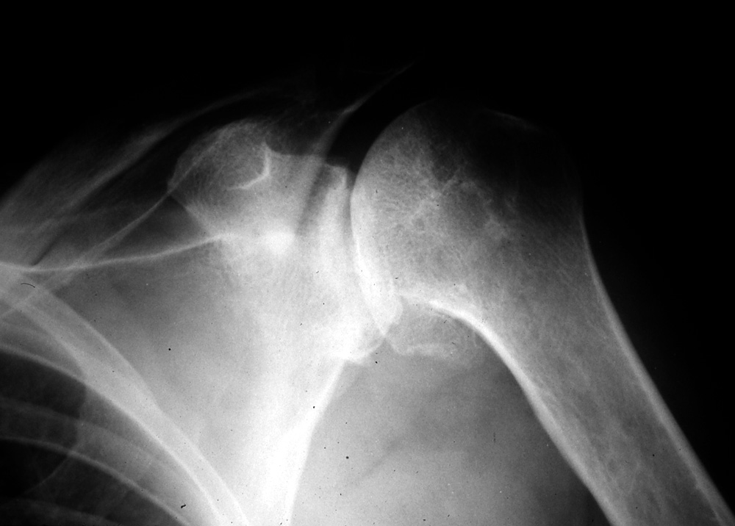
Total Shoulder Replacement

Slide 6
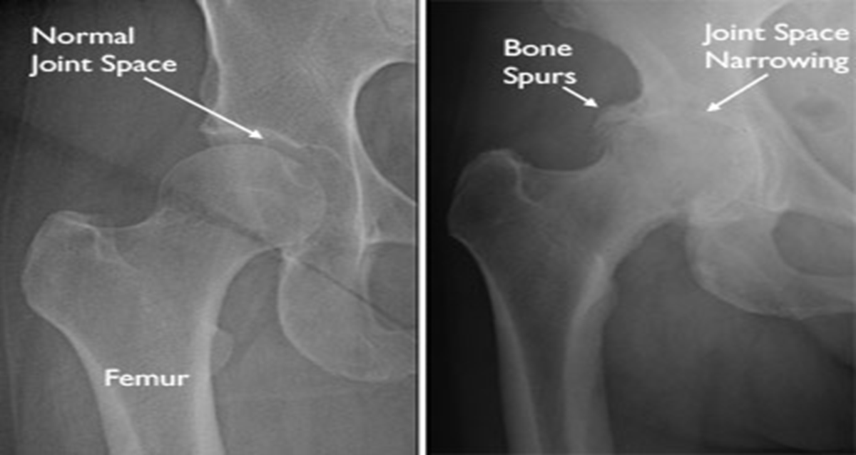
X-ray of a degenerative hip

Slide 7
Hip Arthritis symptoms
Groin and buttock pain with activity then later at rest.
Decreased exercise tolerance with catching and pain.
Limited range of motion.

Slide 8
Surgical options
Arthroscopy for labrum tears
Total hip replacement

Slide 9
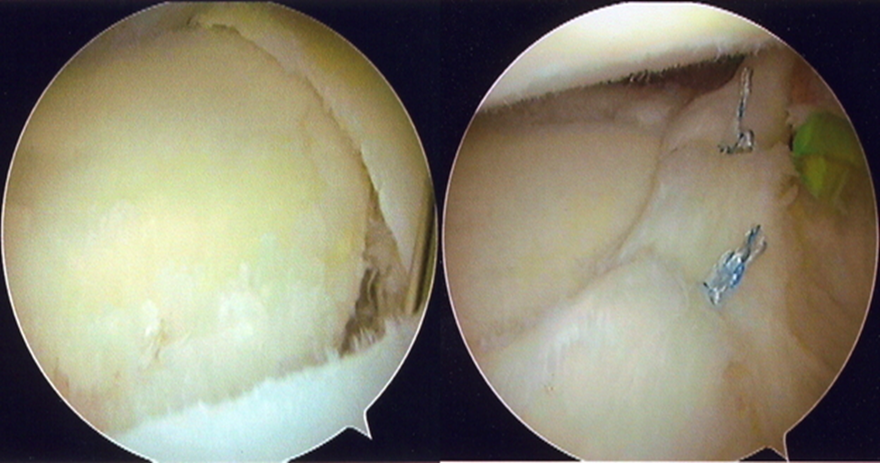
Surgical options
Hip Arthroscopy for labrum tears or loose body

Slide 10
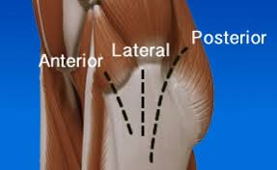
Hip Replacement Surgical approach
MIS anterior MIS posterior

Slide 11
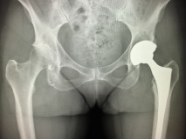
Xrays after hip Replacement
Metal stem and cup

Slide 12
The fundamental problem in hip replacement design was bearing surface wear, leading to loosening
Improvements included
Better plastic or polyethylene
Ceramic bearings
Metal on metal bearing

Slide 13
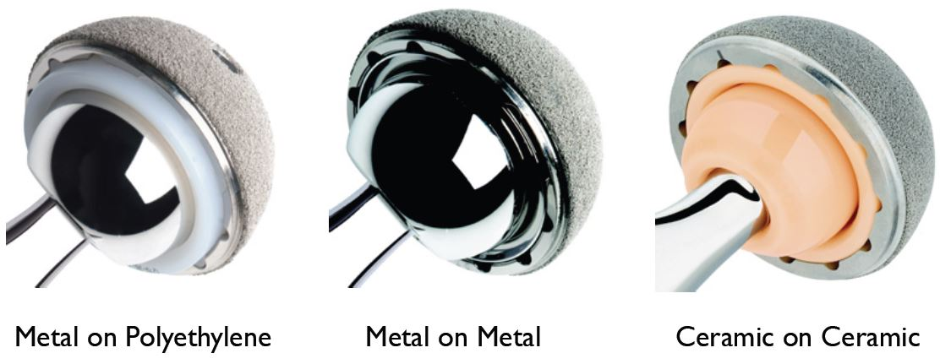
Bearing options

Slide 14
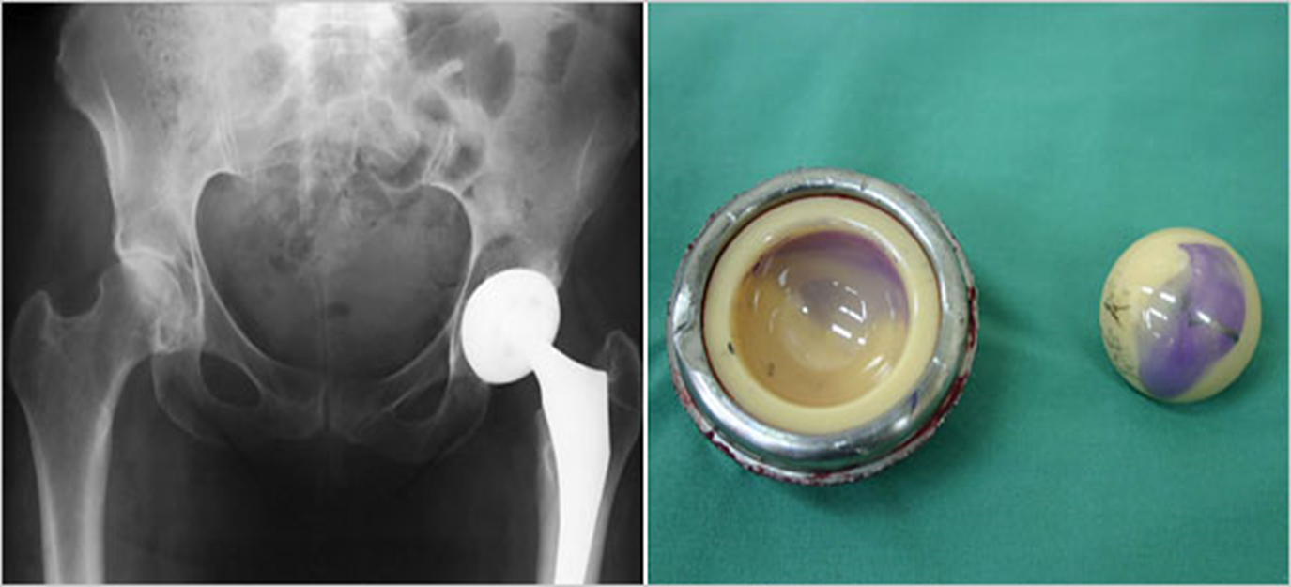
Squeaking ceramic hip
Like a wet finger on glass

Slide 15
Bearing options

Slide 16
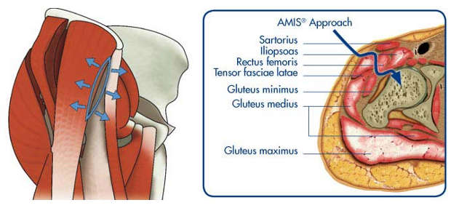
Anterior approach
No Muscles or tendons cut

Slide 17
Anterior vs posterior
Anterior Approach
Less pain in the first 2 weeks.
Return to work on average 2 weeks sooner.
More blood loss, need special training and the hana table.
Lower dislocation rate.
Larger area of numbness around the incision.
Not possible with Obesity and some pelvic anatomy.
No long term functional or survival differences.

Slide 18
Rapid Rehab
Premise. You will feel better in your own home under the care of your loved ones. With the right education and support you are better off at home than in a hospital.
Multimodal pain control allows for early activity.
Rapid mobilization leads to faster recovery, lower risk of blood clots, and stiffness.
Rapid rehab get you back to a normal life and work faster.

Slide 19
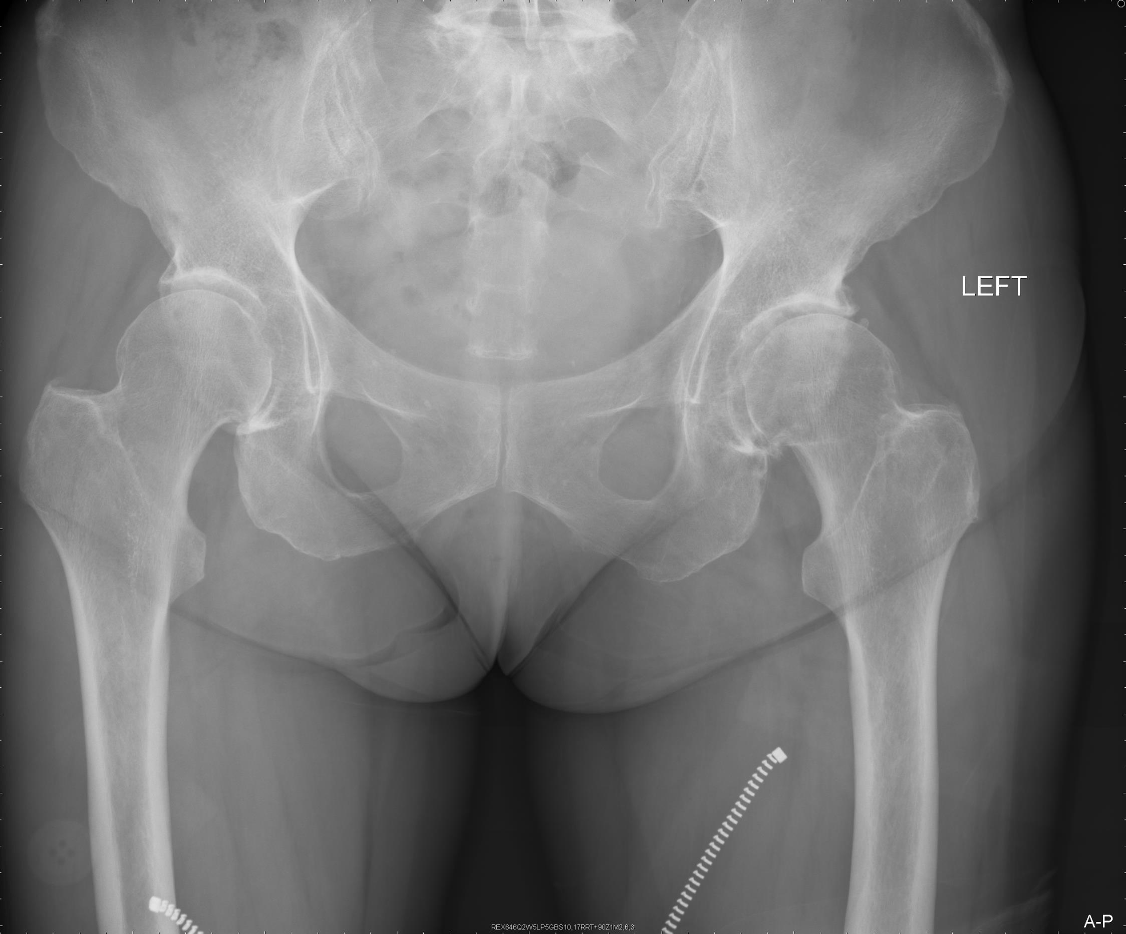

Slide 20
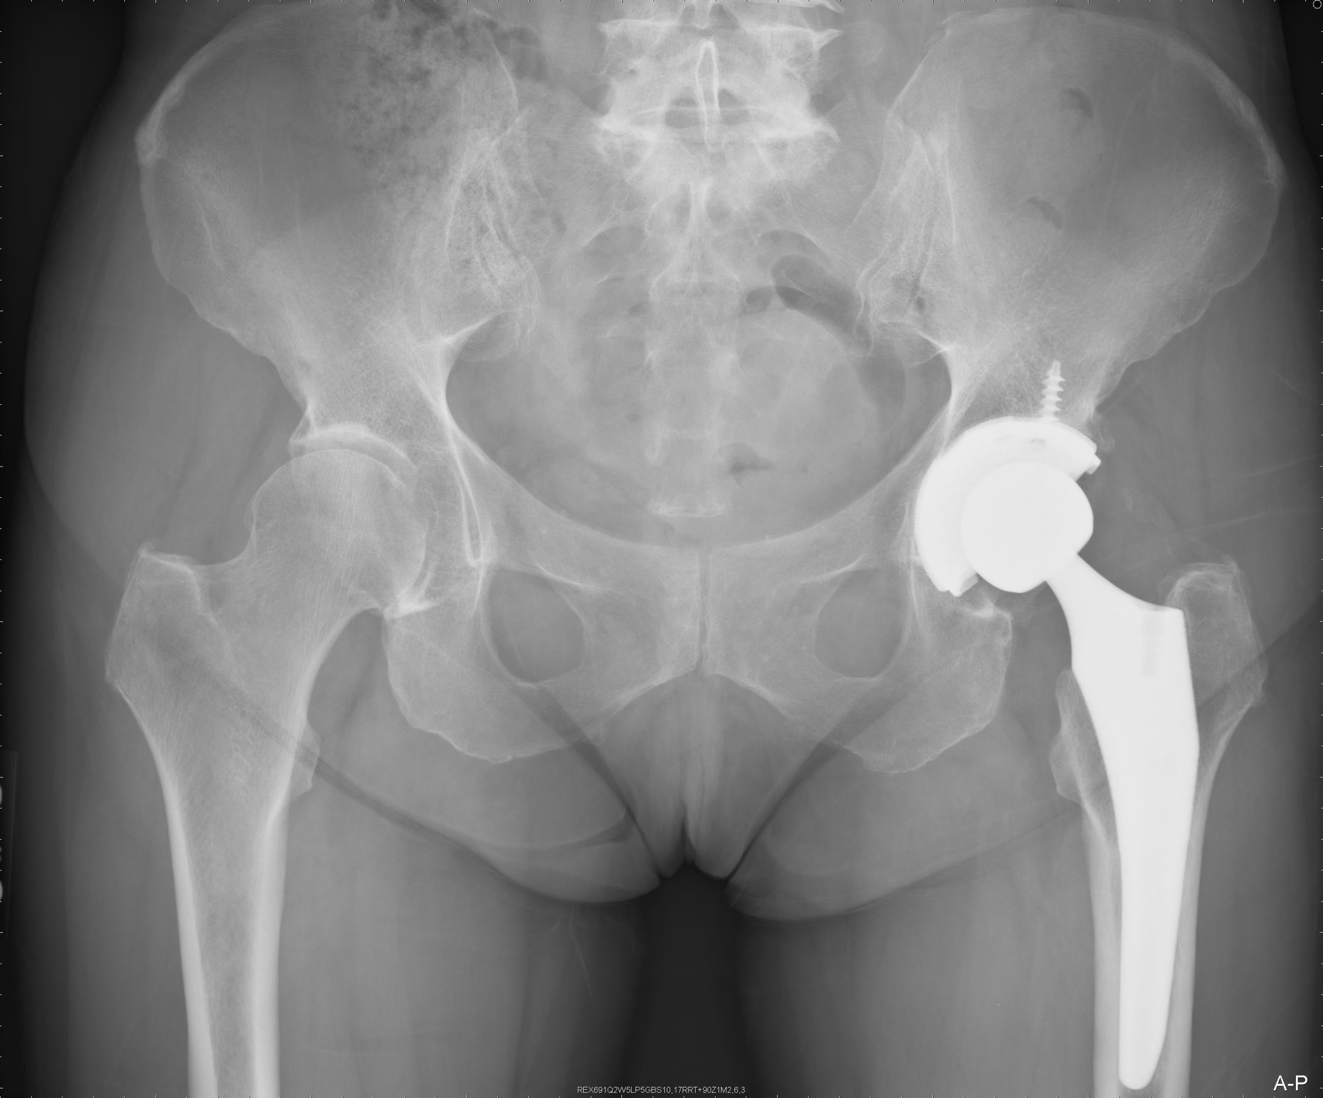

Slide 22
Surgical options
Arthroscopy
Partial Knee Replacement
Total Knee Replacement

Slide 23
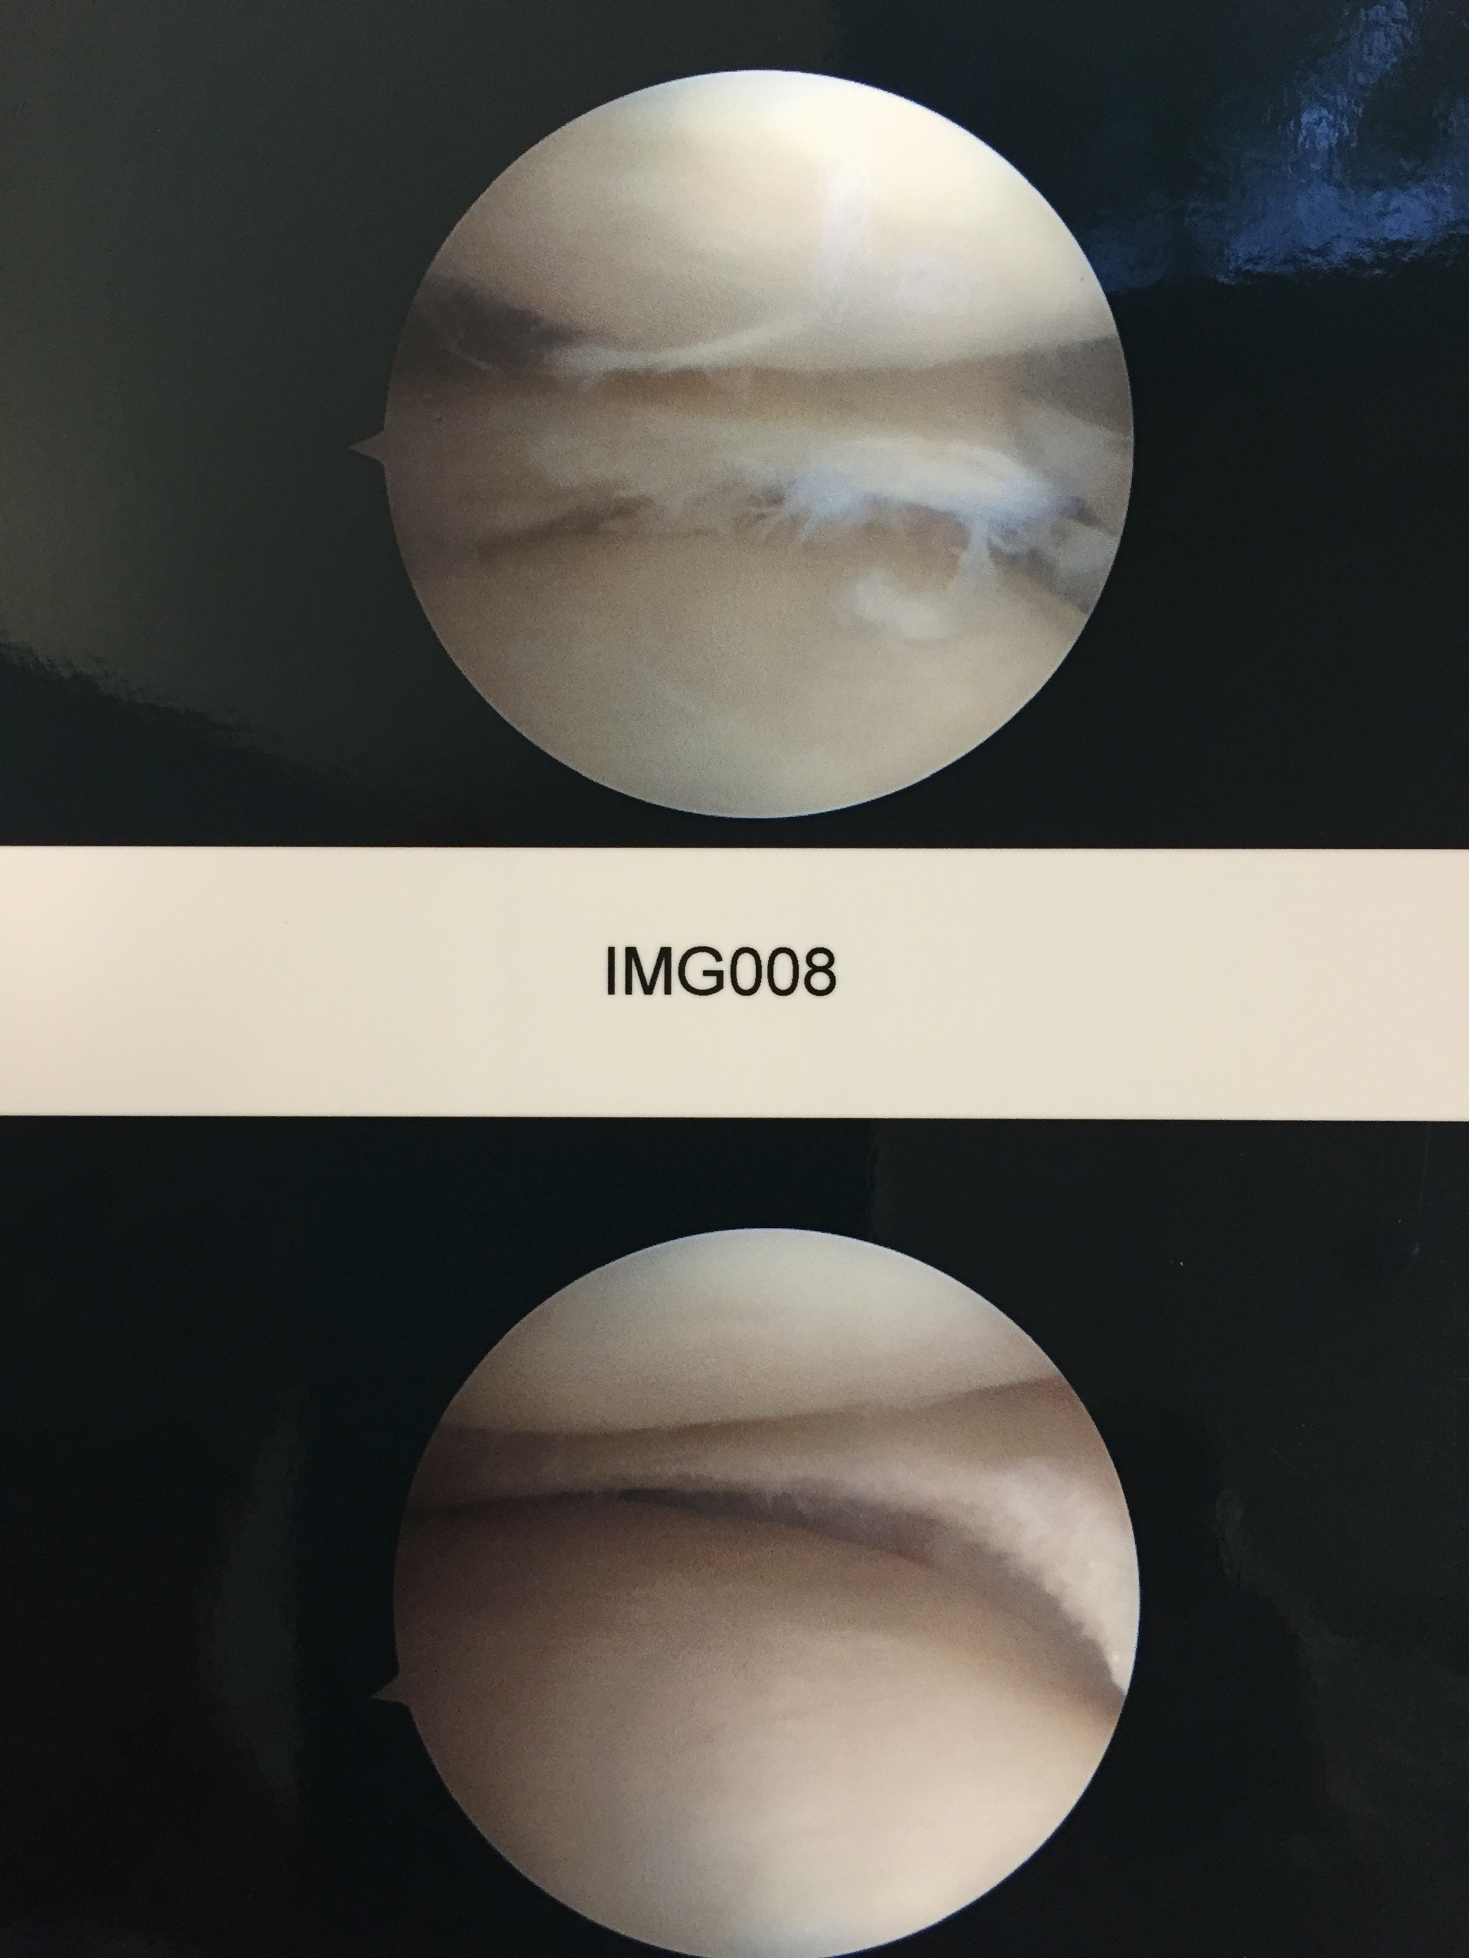

Slide 24
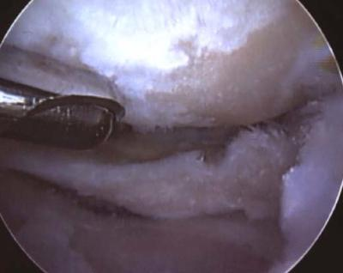
Arthroscopy?

Slide 25
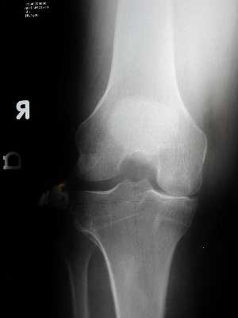

Slide 27
COMPUTER NAVIGATION AND ROBOTIC NAVIGATION IN JOINT REPLACEMENT

Slide 28
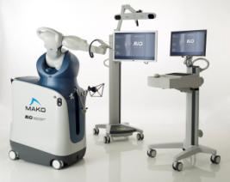
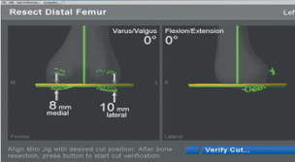
Surgical Technique
General principles
Minimally Invasive Surgery “MIS”, “Mini-incision”
Computer Assisted Surgery or “Navigation”
Robotic - MAKOPLASTY

Slide 29
MIS Knee Replacement
Faster Recovery
Improved Quads Function
Less Pain
Smaller Incisions
Better ROM
More Radiographic Outliers
Computer Navigation Recommended

Slide 30
Afferent Pathways
Anterior
Femoral
Common Peroneal
Saphenous
Posterior
Common Tibial
Post. Tibial

Slide 31
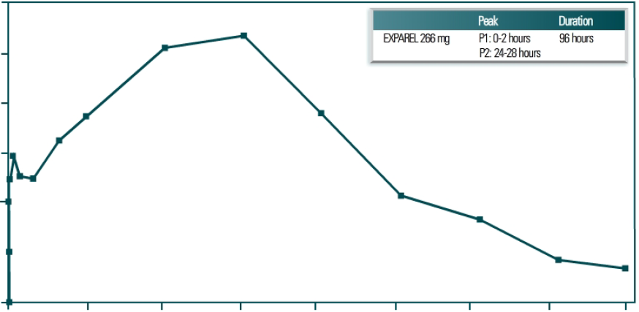
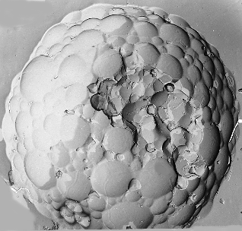
Exparel Pharmacokinetics
300
250
200
Second peak due to slow release of bupivacaine from DepoFoam
Plasma Bupivacaine Concentration (ng/mL)
150
100
Initial peak due to 3% extraliposomal bupivacaine
50
0
0
Time (Hours)
24
48
72
96
Presented at the 2009 International Anesthesia Research Society Annual Meeting; March 14-17, 2009; San Diego, CA.
Notes:
KEY POINT: This slide illustrates the pharmacokinetic curve typically seen following a single intraoperative injection of EXPAREL.
Microscopic spherical particles composed of internal aqueous chambers containing an active drug ingredient
Each chamber is separated from adjacent chambers by lipid membranes
DepoFoam particles release drug over an extended period by erosion and/or reorganization of the particles’ lipid membranes
Release rates determined by relative amounts of lipids and manufacturing know-how

Slide 32
TIME COURSE OF PAIN
VAS
HOURS

Slide 33
“SwiftPath Patient Selection Tool”
1) PATIENT MOTIVATION (4)
0=MIN 2=MOD 4=MAXIMUM
2) Comprehension (4)
0=POOR 2=MOD 4=EXCELLENT
2) FAMILY SUPPORT (2)
0=POOR 2=GOOD 4=EXCELLENT
3) HOME SET UP (2)
0=POOR 1=GOOD 2=EXCELLENT
4) PATIENT AGE (5)
0>75 1:70-75 3:65-70 4:60-65 5<60
5) PATIENT BMI
0=>37 2=31-37 4<30
6) PATIENT PROXIMITY TO HOSPITAL
0=>2HOURS 1= 1-2 HOURS 2=<1 HOUR
7) Modified Charleson Index (HTN, DM, CAD, ASTHMA/COPD, CVA, SLEEP APNEA
0= > 4 2= 3,4 4= 1,2 6=0,1
8) PREOP PT CONSULT
0= FAIL 4=PASS
TOTAL POINTS= 35
Notes:
3 VARIABLES THAT DICTATE RESULTS: PROPER PATIENT SELECTION DICTATES OUTCOMES

Slide 34
Contra-Indications
Unstable Arrhythmias
Dementia
Untreated Sleep Apnea
End Stage Medical Problems
CHF
Cirrhosis
COPD
Poorly Controlled DM
No Family Support
Unmotivated Patient
Previous Arthrotomy/risk of skin compromise
Notes:
Military operation (sometimes there are land mines)
Berger notes in his studies that age and BMI no an issue in his outpatient joints…
What are the limits/indications
New scale to assess appropriate pateints

Slide 35
Modern Pain Management
MIS Techniques
Multimodal Pain Management
Patient Selection and
Pre-operative Education

Slide 36
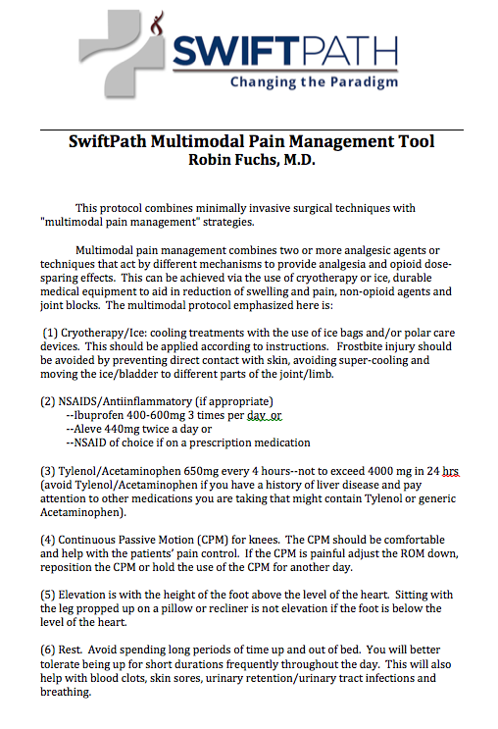
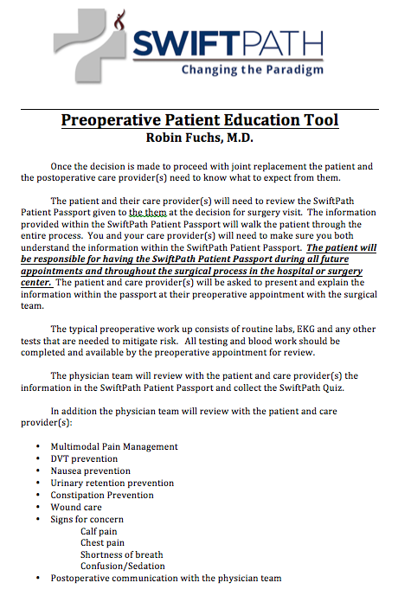
PREOPERATIVE
Patient Selection
Education
Preparation
OPERATIVE
Pre-emptive Analgesics
MIS Techniques
Computer Navigation
Joint Blocks
POSTOPERATIVE
Pain Management
Notes:
Its all about the tools

Slide 37
“changing the paradigm”
Telemetry
Inpatient Rehab
Skilled Nursing Facility
Home Health
Labs
Readmissions
0
1
2
3
4
5
Notes:
JOINT REPLACEMENT; HENRY FORD “ANY COLOR YOU WANT”
McAllister vs Rothman in Journal of arthroplasty

Slide 38
Thank You!

